Slide 1
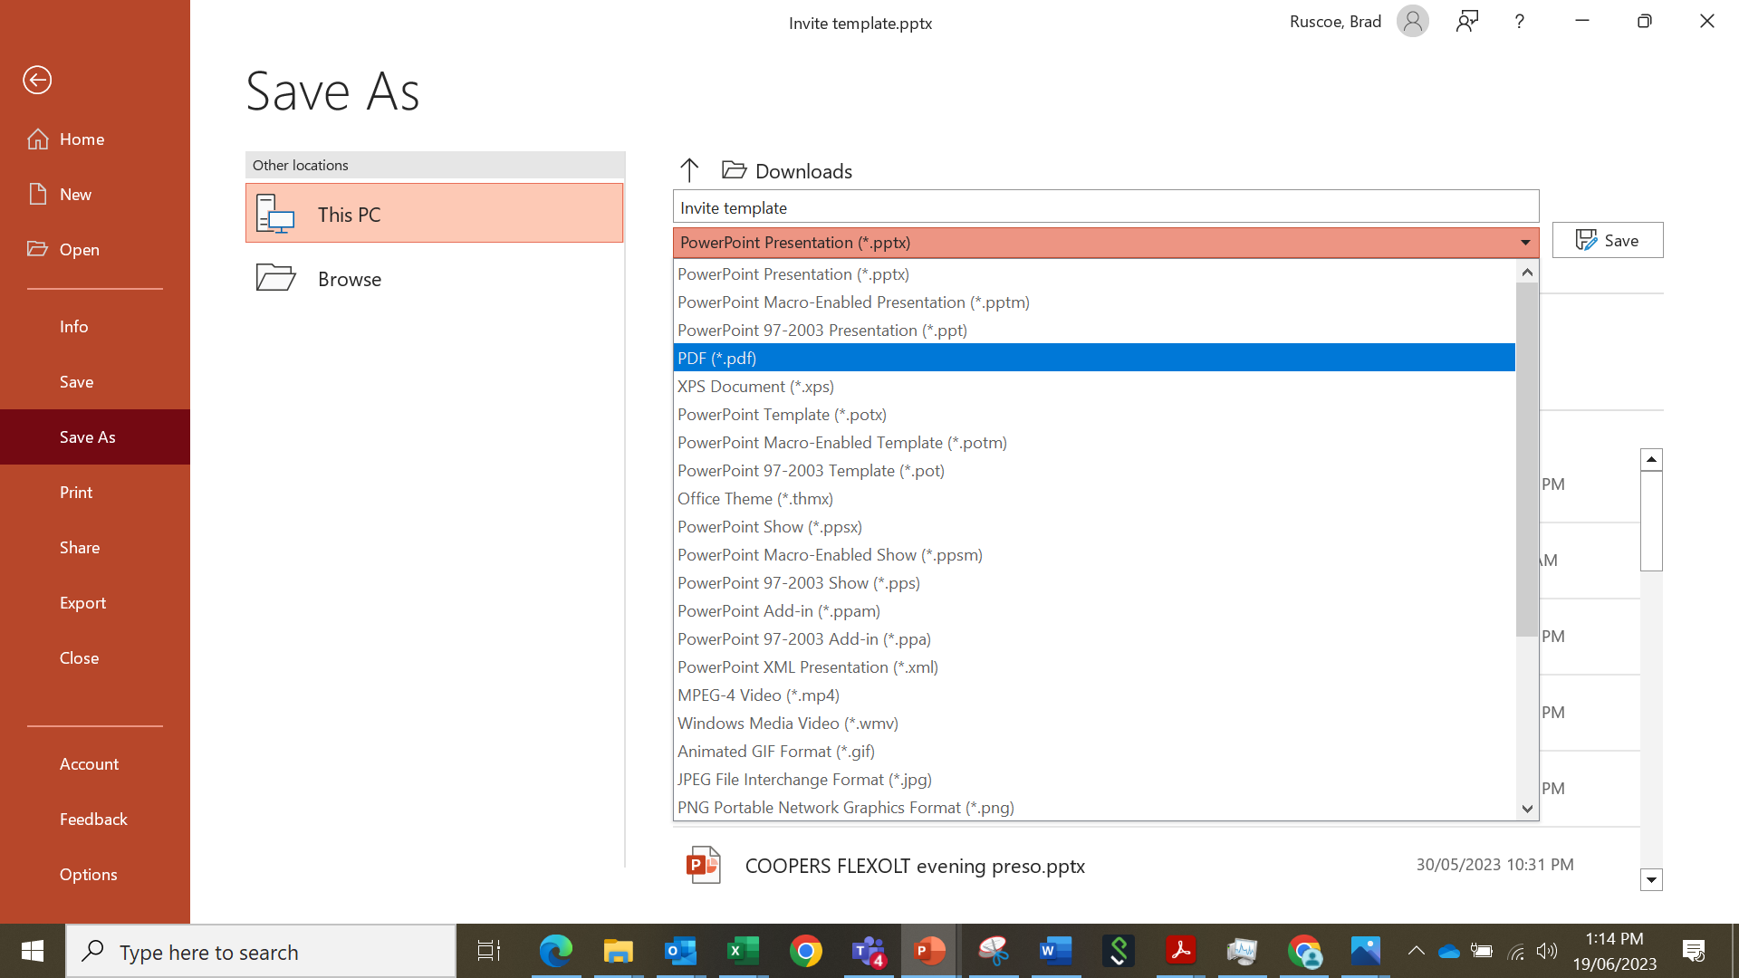
Instructions
Open blank Invite powerpoint template
SAVE AS – file name of event
Then complete one invite with details. There are 2 kinds.
One for single location events – simple fields
One (blank) for adding in multiple events / space for more information
Complete relevant invite page
Delete the unused pages
File >> SAVE AS >> choose file type
This PDF can be printed or emailed to stores / farmers

