Slide 1
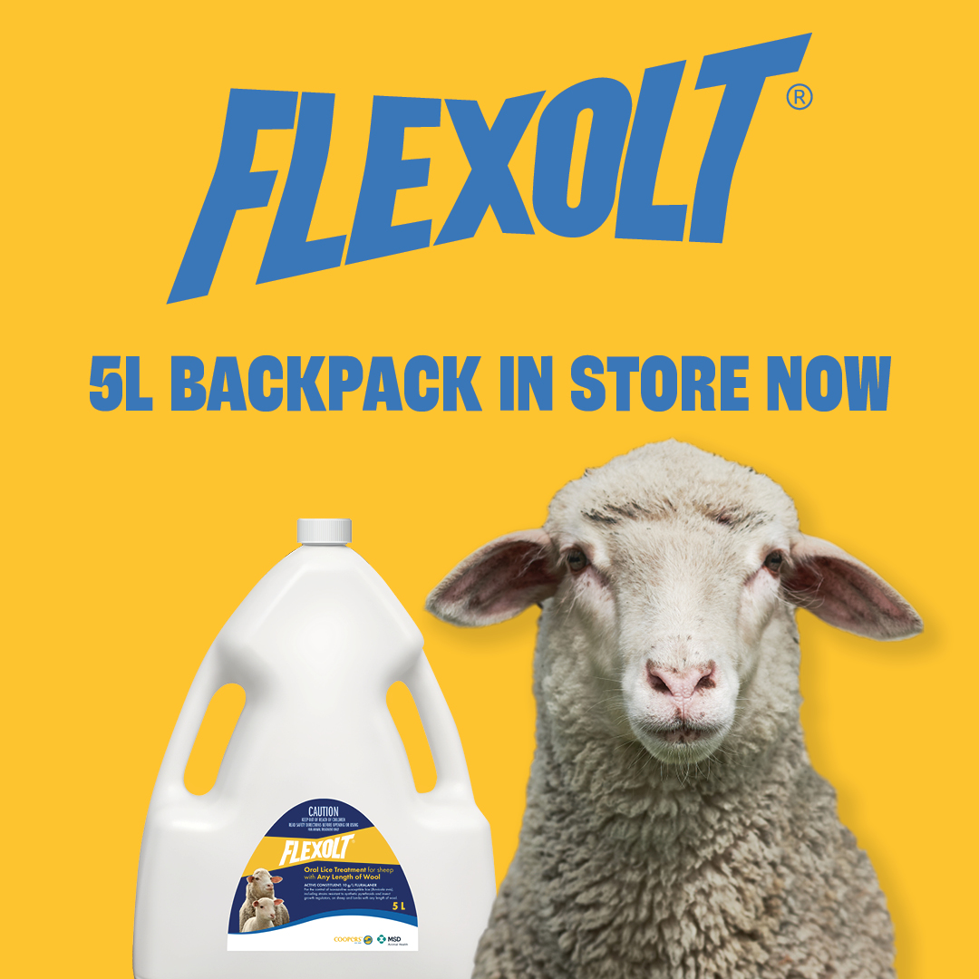
Type: JPG
Size: 1080 x 1080px
Copy:
New size, same flex. Flexolt changes everything in lice control and now comes in a convenient 5 litre backpack, that treats up to 555 sheep (@60kg). Head in store and pick up a new 5 litre backpack of Flexolt today.
To learn more about this revolution in lice control visit www.coopersanimalhealth.com.au

Slide 2
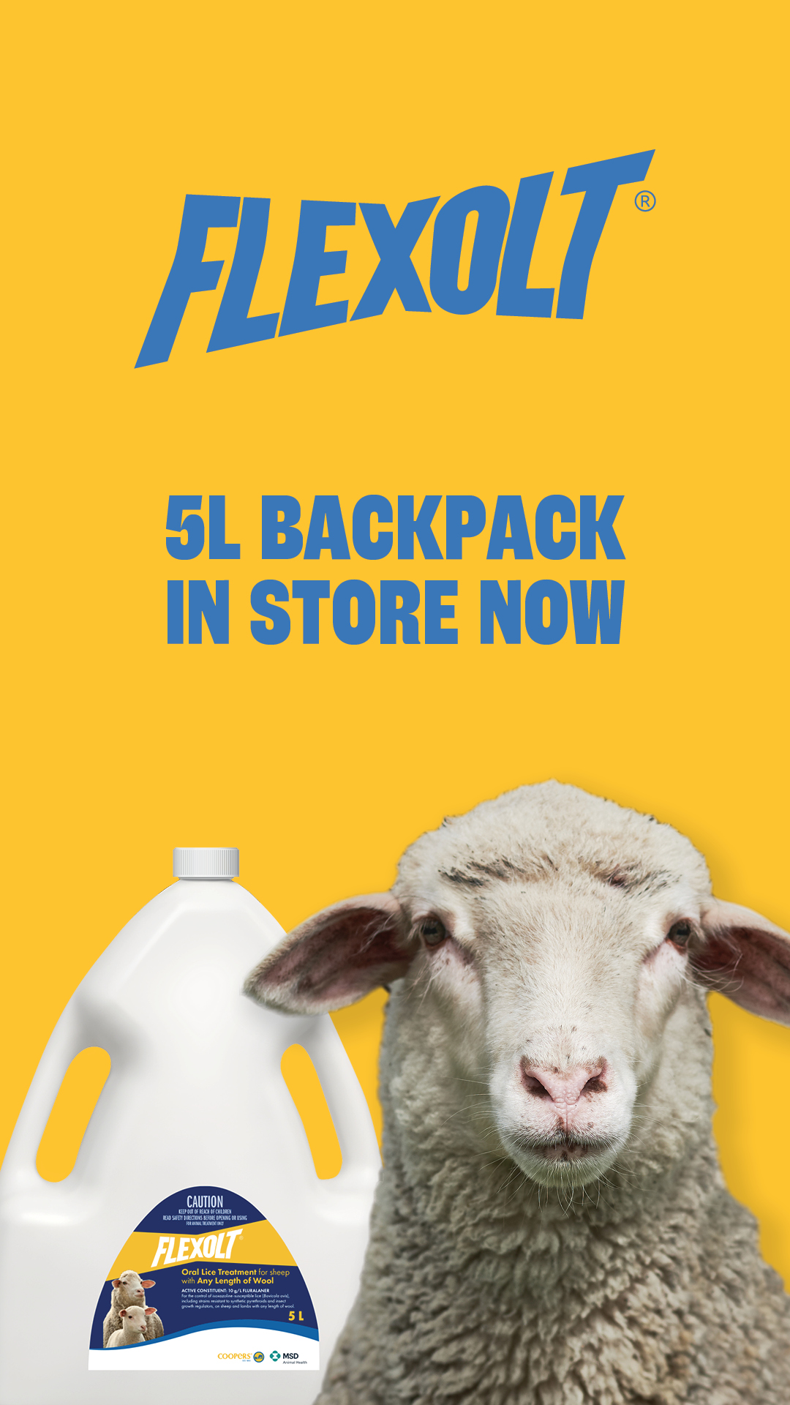
Type: JPG
Size: 1920 x 1080px
Copy:
New size, same flex. Flexolt changes everything in lice control and now comes in a convenient 5 litre backpack, that treats up to 555 sheep (@60kg). Head in store and pick up a new 5 litre backpack of Flexolt today.
To learn more about this revolution in lice control visit www.coopersanimalhealth.com.au

Slide 3
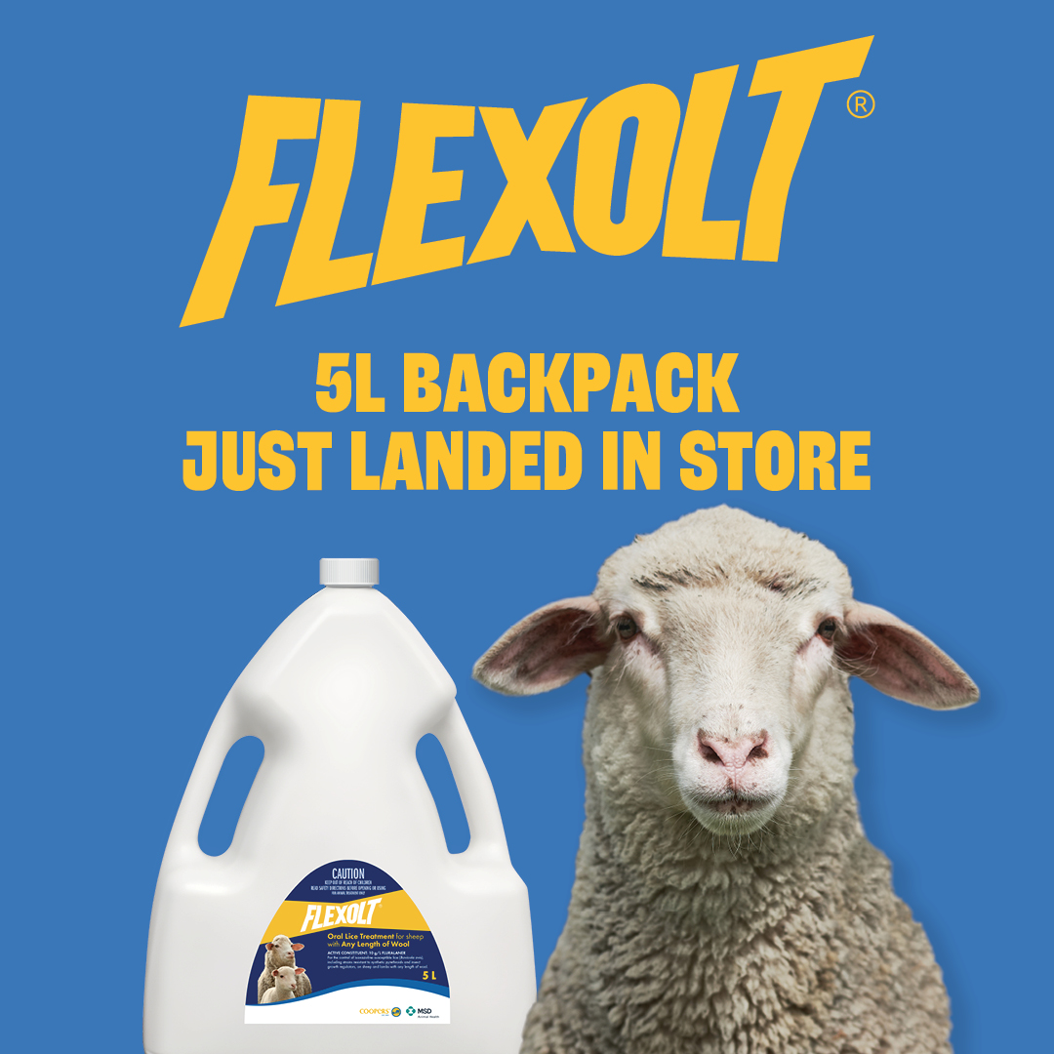
Type: JPG
Size: 1080 x 1080px
Copy:
Offering even more flexibility in controlling lice, the convenient new 5 litre Flexolt backpack has finally hit the shelves. Head instore and pick yours today.
To learn more about this revolution in lice control visit www.coopersanimalhealth.com.au

Slide 4
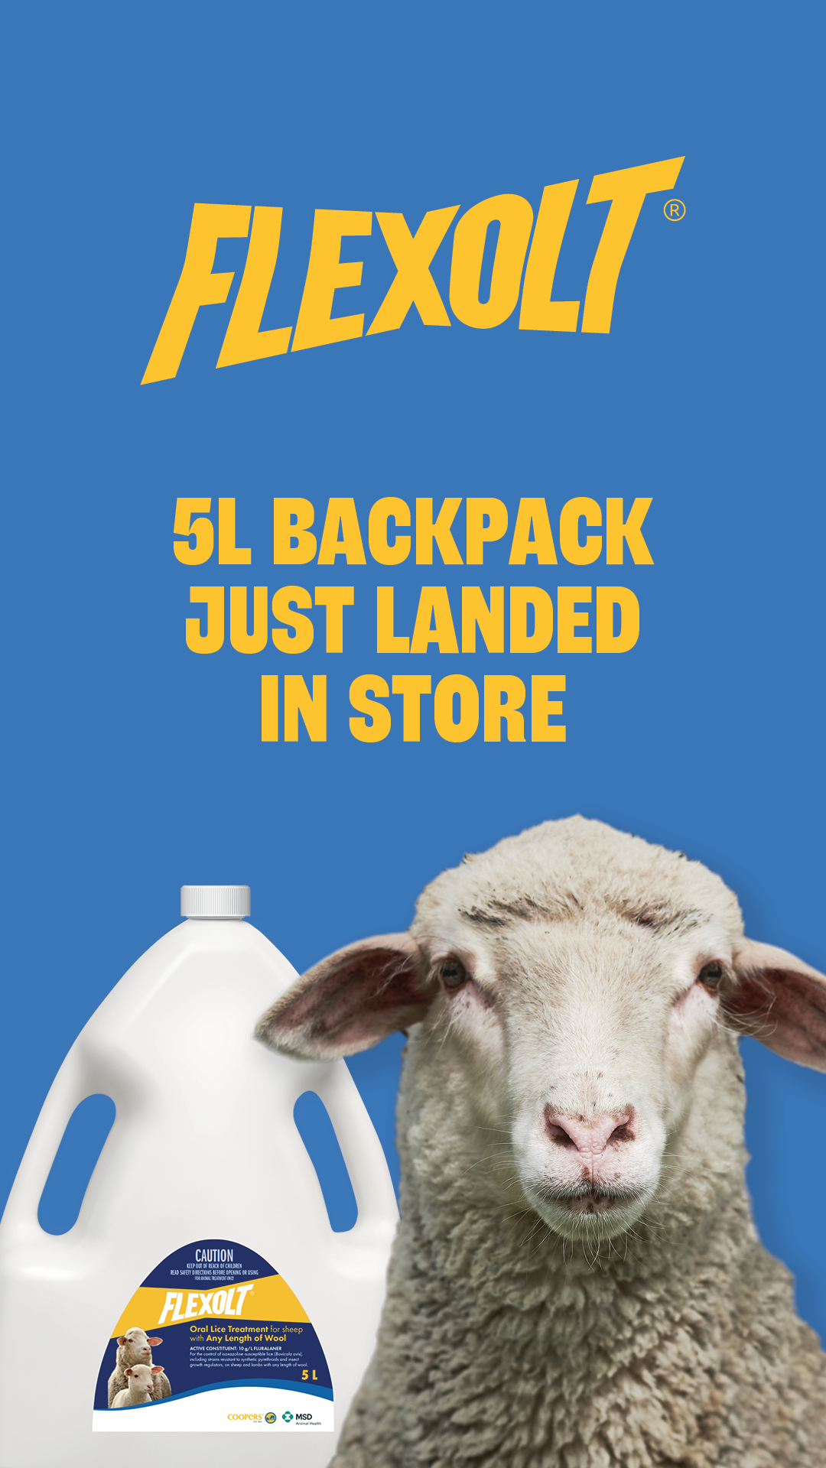
Type: JPG
Size: 1920 x 1080px
Copy:
Offering even more flexibility in controlling lice, the convenient new 5 litre Flexolt backpack has finally hit the shelves. Head instore and pick yours today.
To learn more about this revolution in lice control visit www.coopersanimalhealth.com.au

Slide 5
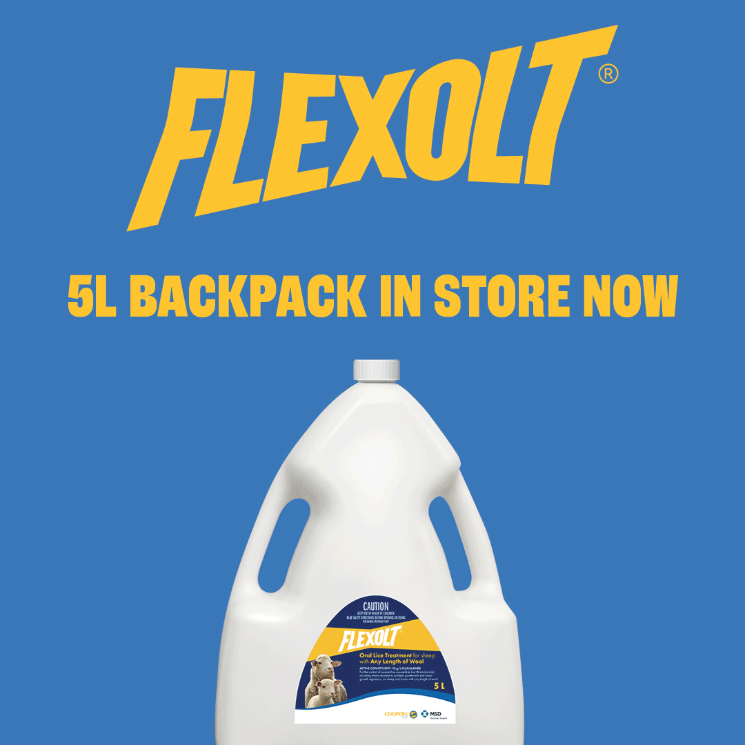
Post 1: GIF
Size: 1080 x 1080px
Copy:
Offering even more flexibility in controlling lice, the brand new 5 litre Flexolt backpack has finally hit the shelves. Head in store and pick yours today.
To learn more about this revolution in lice control visit www.coopersanimalhealth.com.au

Slide 6
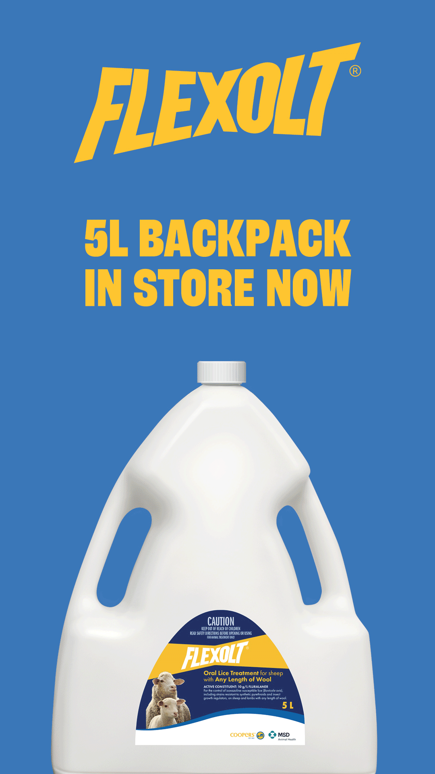
Type: GIF
Size: 1920 x 1080px
Copy:
Offering even more flexibility in controlling lice, the brand new 5 litre Flexolt backpack has finally hit the shelves. Head in store and pick yours today.
To learn more about this revolution in lice control visit www.coopersanimalhealth.com.au

